Slide 1
Digital Transformation and Collaborative Innovation:
The Role of Governance when Hierarchies become Networks?
Malcolm Fraser, Executive Director, The Collaborative

Slide 2
Agenda
How Hierarchies have become networks and the role of Digital Technologies in this transformation
To identify Collaborative Windows of opportunity that open and close across your organisation and its economic, political and social contexts
Craft adaptive Governance Structures at the inter-organizational level to cope with the highly dynamic and constantly shifting nature of collaborative innovation networks

Slide 3
Let’s Talk About

Slide 4
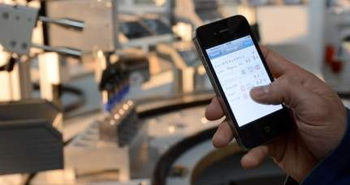
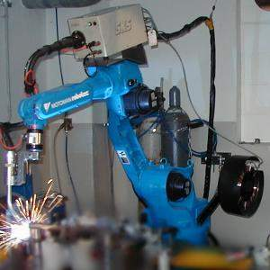
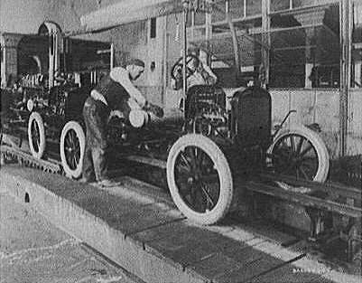
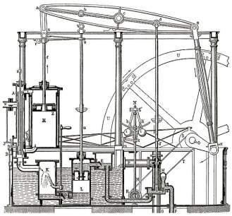
Industrial Evolution
4. Industrial revolution
Based on cyber-physical-
systems
3. Industrial revolution
Through the use of electronics
and IT further progression in
autonomous production
2. Industrial revolution
Introducing mass production
lines powered by electric
energy
Level of complexity
1. Industrial revolution
Introducing mechanical
production machines powered
by water and steam
Industry 1.0
Industry 2.0
Industry 3.0
Industry 4.0
Source: DFKI/Bauer IAO

Slide 5
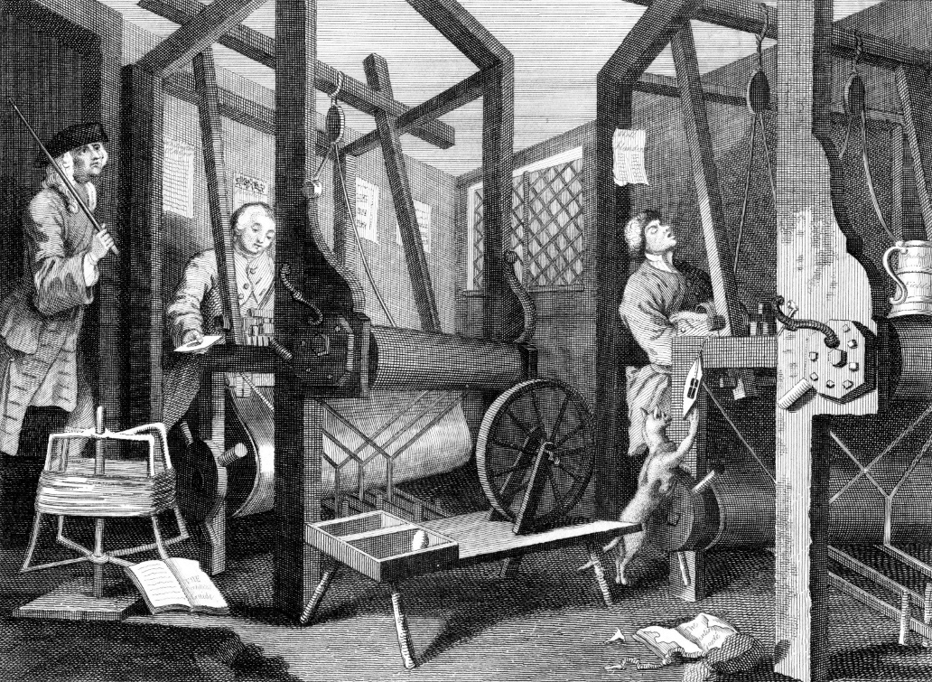
Industry 1.0
Prior to the 1st Industrial Revolution, enterprise was under-taken by individual entrepreneurs and crafts people located in communities close to the raw material supply (wool)

Slide 6
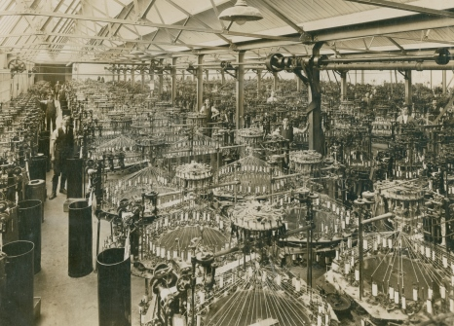
Industry 1.0
Across the 18th to 19th Centuries the 1st Industrial Revolution transformed these small local enterprises into large factories powered by water mills and steam engines, and the Hierarchy was born!

Slide 7
Hierarchies
Production Line

Slide 8
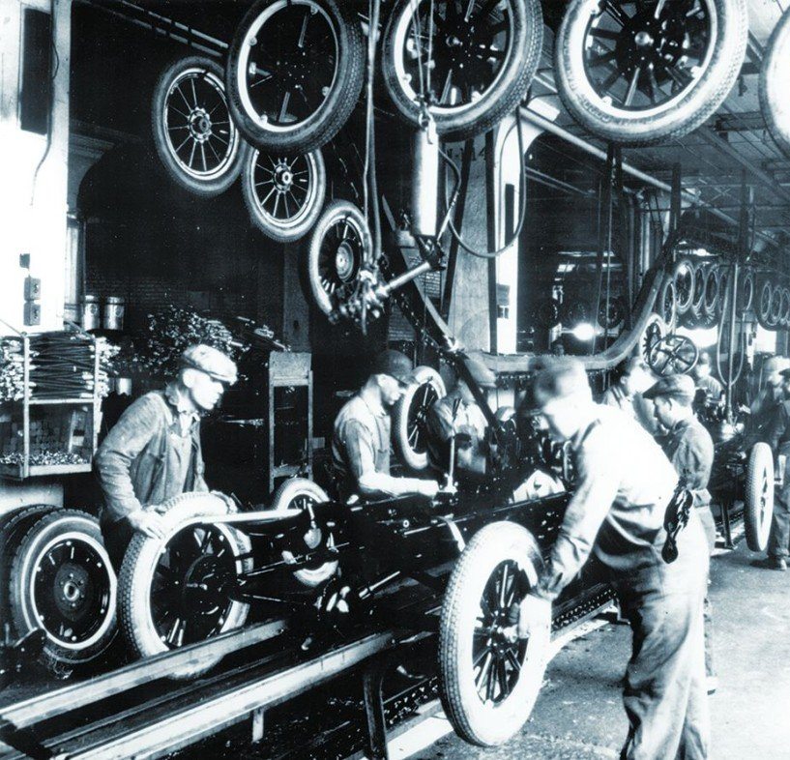
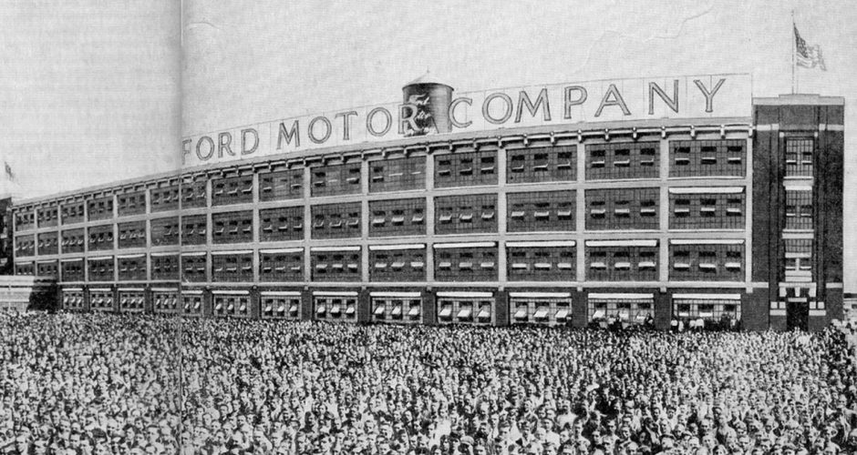

Slide 9
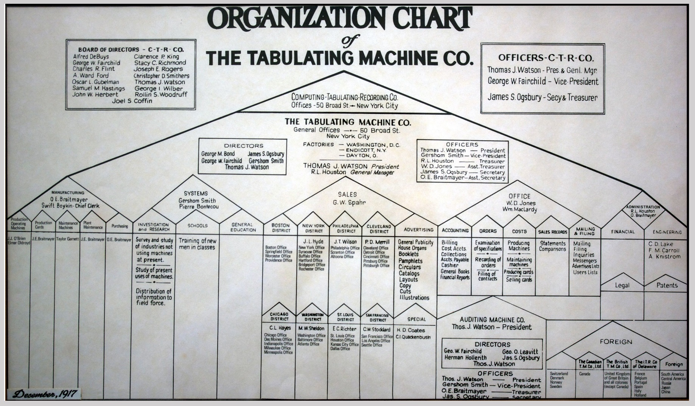
Governance
Boards
Presidents
Chairman
Directors
Secretaries
Treasurers

Slide 10
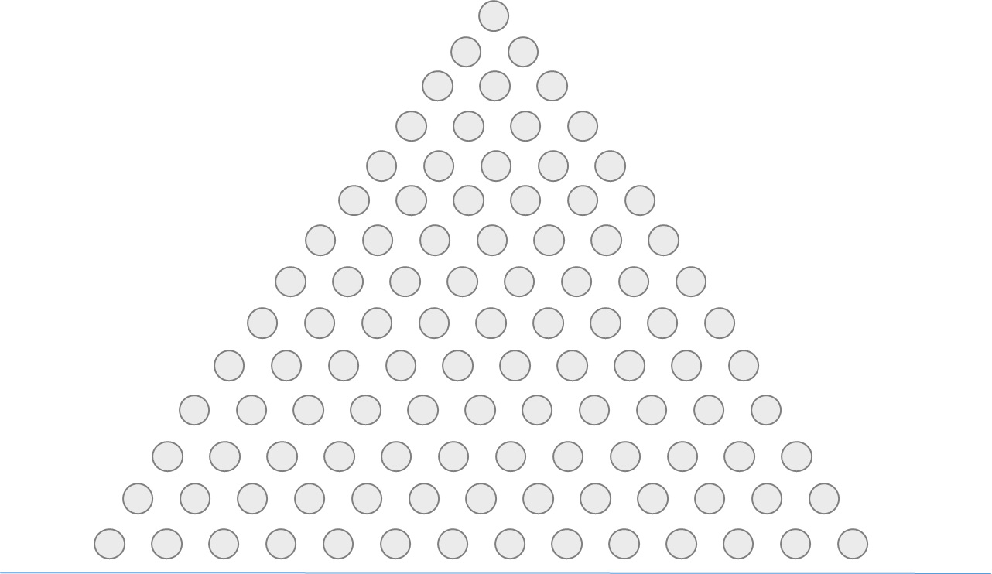
Communication in a Hierarchy?

Slide 11
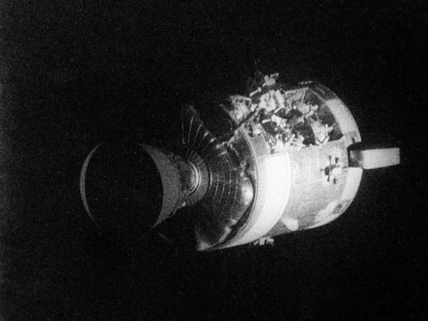
Tiger Teams 1964
Problem:
Apollo 13 Explosion
Solution:
Horizontal Tiger Team
Execution:
Project Based (solve the problem)
"a team of undomesticated and uninhibited technical [cross functional] specialists, selected for their experience, energy, and imagination, and assigned to track down relentlessly every possible source of failure in a spacecraft subsystem"

Slide 12

Cross Functional Communications

Slide 13
Then,
The Internet

Slide 14
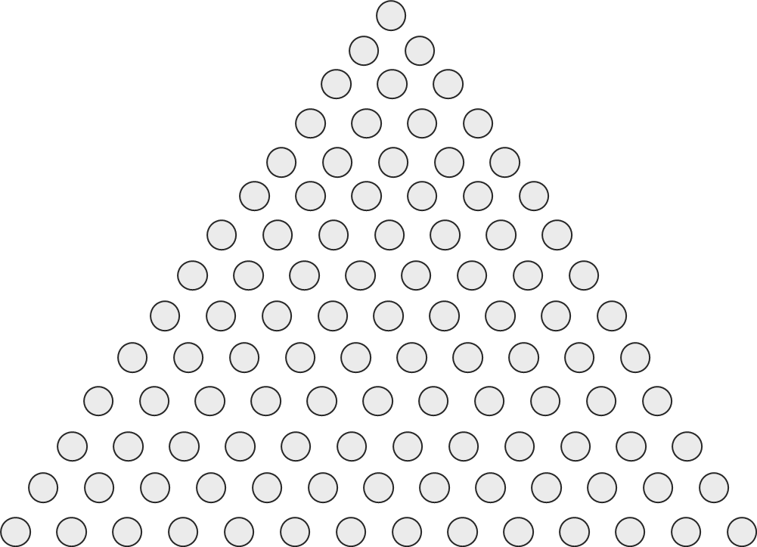
Accelerating Collaboration and Interaction
Then
Now
Communications are
horizontal and cross organizational
Hierarchies have gotten flatter
Working in multi team/multi org Projects is the new normal

Slide 15
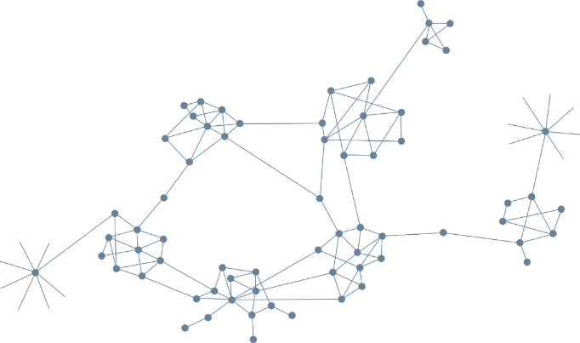
4th Industrial Revolution
Cyber-physical-Systems, and…
Collaborative Networks

Slide 16
Yesterdays Factory
Rigidly Sequenced

Slide 17
Tomorrows Factory
De-coupled, fully flexible and highly integrated

Slide 18
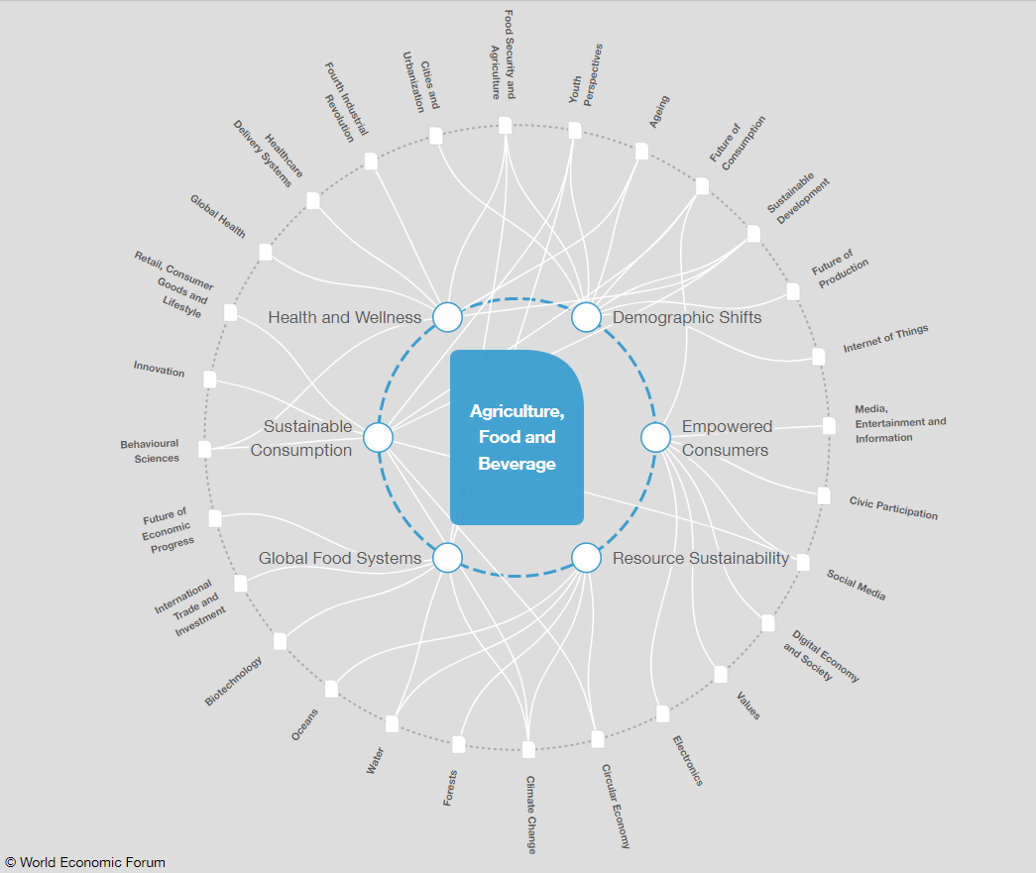
Value Webs

Slide 19
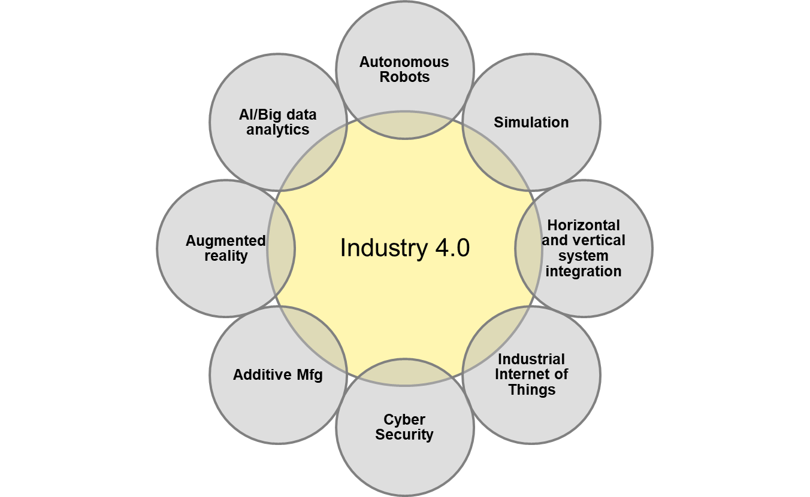
Industry 4.0
Interoperability: Humans and Smart Factories to connect and communicate with each other
Virtualization: a ‘digital twin’ of the Smart Factories and Industry Value Chains/Webs
Decentralization: the ability of cyber-physical systems within Smart Factories to make decisions on their own
Real-Time Capability: the capability to collect and analyze data and provide the insights immediately
Modularity: flexible adaptation of Smart Factories for changing requirements of individual modules
Notes:
Interoperability: the ability of cyber-physical systems (i.e. work piece carriers, assembly stations and products), humans and Smart Factories to connect and communicate with each other via the Internet of Things and the Internet of Services
Virtualization: a virtual copy of the Smart Factory which is created by linking sensor data (from monitoring physical processes) with virtual plant models and simulation models
Decentralization: the ability of cyber-physical systems within Smart Factories to make decisions on their own
Real-Time Capability: the capability to collect and analyze data and provide the insights immediately
Service Orientation: offering of services (of cyber-physical systems, humans and Smart Factories) via the Internet of Services
Modularity: flexible adaptation of Smart Factories for changing requirements of individual modules

Slide 20
Building Blocks
Notes:
Interoperability: the ability of cyber-physical systems (i.e. work piece carriers, assembly stations and products), humans and Smart Factories to connect and communicate with each other via the Internet of Things and the Internet of Services
Virtualization: a virtual copy of the Smart Factory which is created by linking sensor data (from monitoring physical processes) with virtual plant models and simulation models
Decentralization: the ability of cyber-physical systems within Smart Factories to make decisions on their own
Real-Time Capability: the capability to collect and analyze data and provide the insights immediately
Service Orientation: offering of services (of cyber-physical systems, humans and Smart Factories) via the Internet of Services
Modularity: flexible adaptation of Smart Factories for changing requirements of individual modules

Slide 21
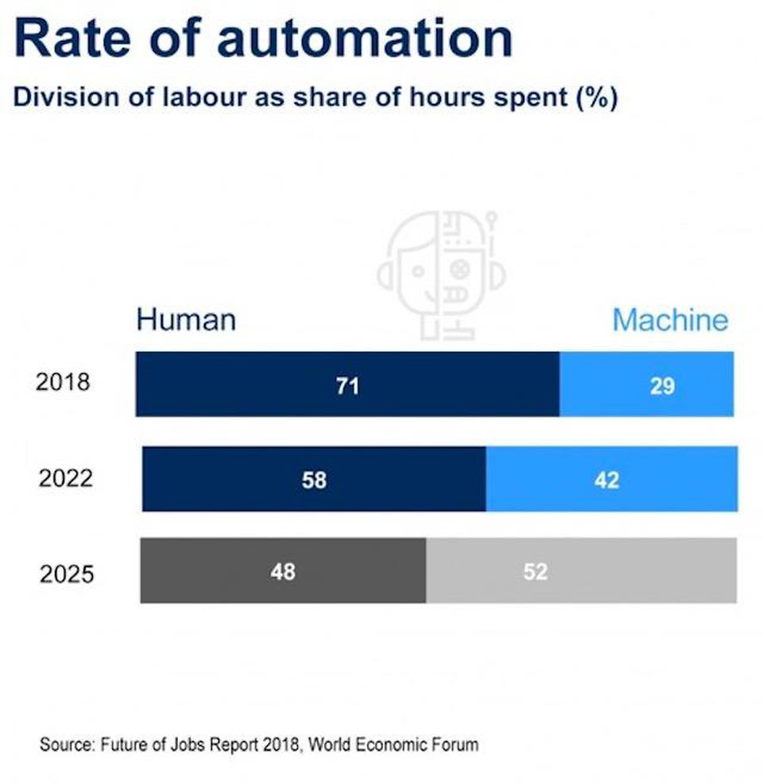
Rate of Automation
Notes:
Interoperability: the ability of cyber-physical systems (i.e. work piece carriers, assembly stations and products), humans and Smart Factories to connect and communicate with each other via the Internet of Things and the Internet of Services
Virtualization: a virtual copy of the Smart Factory which is created by linking sensor data (from monitoring physical processes) with virtual plant models and simulation models
Decentralization: the ability of cyber-physical systems within Smart Factories to make decisions on their own
Real-Time Capability: the capability to collect and analyze data and provide the insights immediately
Service Orientation: offering of services (of cyber-physical systems, humans and Smart Factories) via the Internet of Services
Modularity: flexible adaptation of Smart Factories for changing requirements of individual modules

Slide 22
Streams and Windows
Organisational, economic, political, social, and environmental ‘streams’
Window of Opportunity:
Open and Close related to streams

Slide 23
Entrepreneurs
(exploiting windows)
Commercial Entrepreneurs
New ventures and start-ups
Social Entrepreneurs
Positive Social and/or environmental impact
Institutional/Policy Entrepreneurs
To better serve communities and economies
Collaborative Entrepreneurs
Multi-party collaborations to 'join-up' organizations

Slide 24
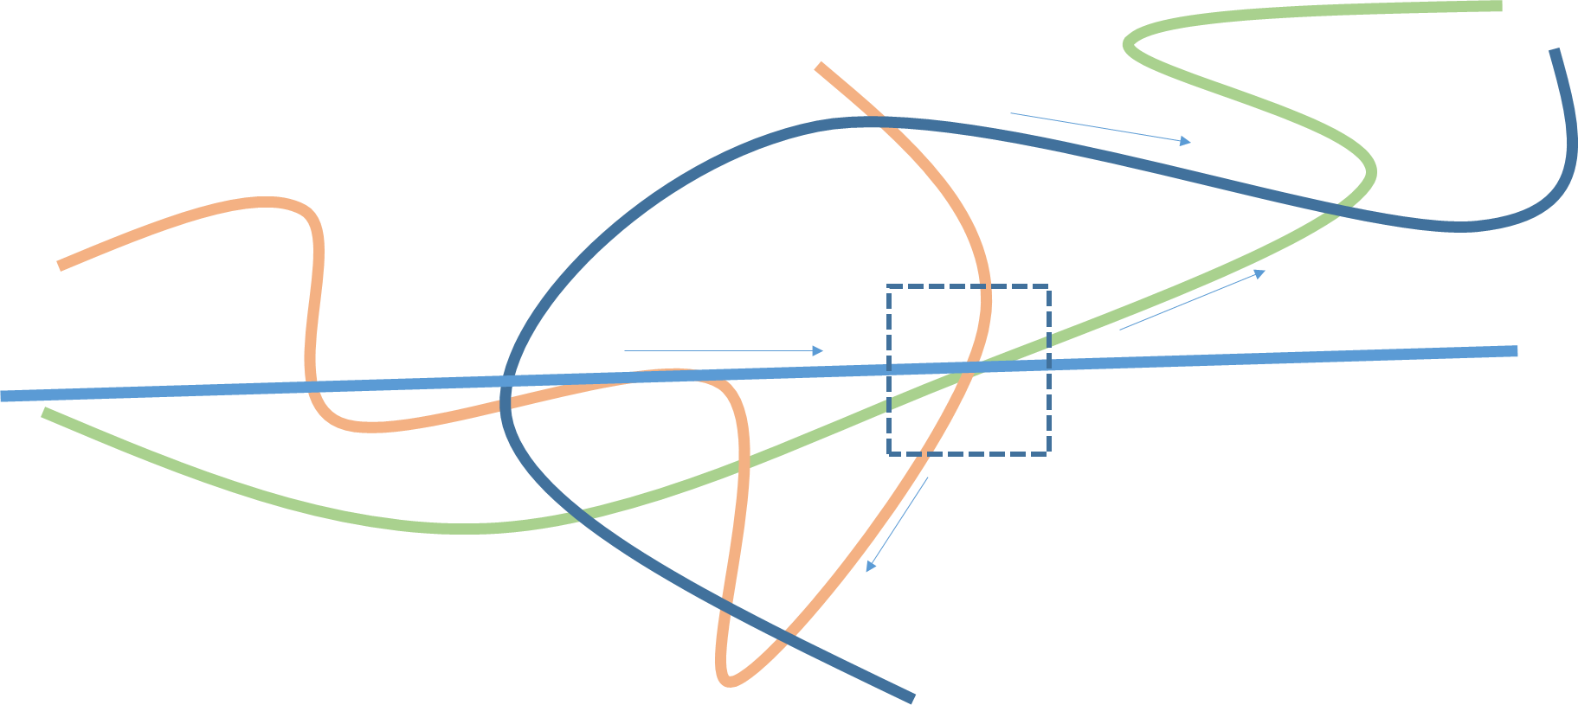

But there is a problem!
Streams Move - Windows Open and Close
Opportunities for Collaboration Appear
But we apply ridged Hierarchal Governance Structures

Slide 25
Fluid Situation
-
Ridged Governance
Collaborations form in response to particular collaborative windows, the initial governance structures developed will correspond to the conditions characterizing the window.
Because initial governance structures are difficult to change and the conditions that characterized the collaborative window shift when the window closes, [collaborative] partnerships have built into them the seeds for their short-term demise.
Collaborative Windows and Organizational Governance: Exploring the Formation and Demise of Social Service Partnerships. Lois M. Takahashi and Gayla Smutny 2002

Slide 26
Designing Governance
Empathize
Define
Ideate
Prototype
Test

Slide 27
Case Study
Collaborative ‘Breeding Ground’ of Opportunity
Industry specific
Collaborative Network ‘Brand’
Flag in the Ground
Collaborative Project Opportunities
Working alone doesn’t work….need to join up
Collaborative Brokerage/Governance
Help people join-up and execute, not build empires

Slide 28
the.collaborative.studio
a social enterprise for collaborative innovation

